Slide 1
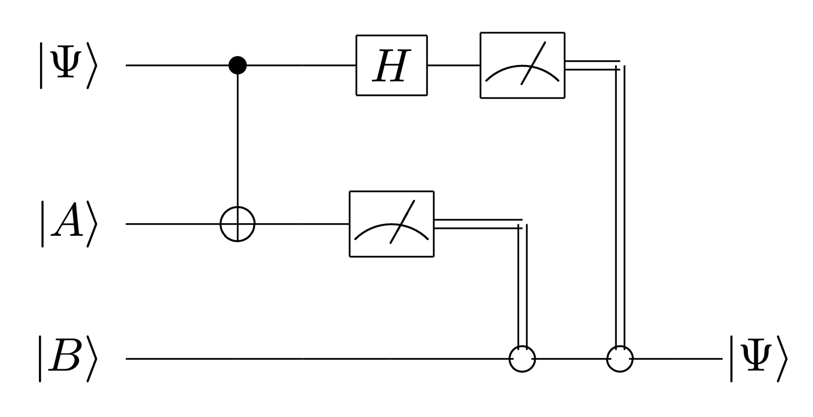
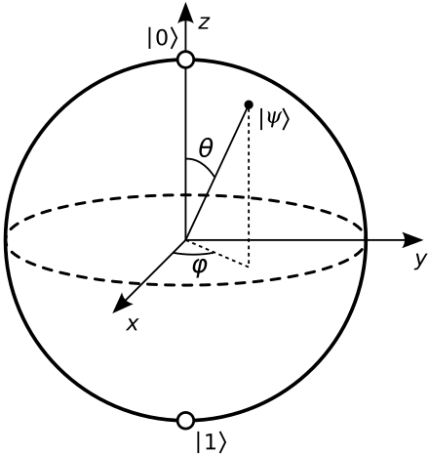
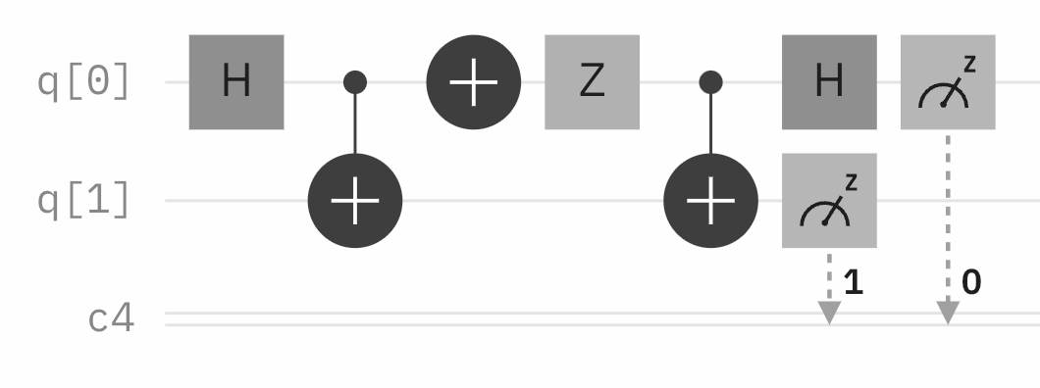
An Overview of Quantum Computing
By Ryan Y. Batubara
Scott Aaronson: “Quantum computers won't
solve hard problems instantly by just trying all solutions in parallel.”
Bra-ket Notation
Define ket and their tensor product as
I0❭ = [ ] I1❭ = [ ]
Ia❭ ⊗ Ib❭ = [ ] ⊗ [ ] =
Multiplication of kets are assumed tensors, and
(A ⊗ B) ⊗ C = A ⊗ (B ⊗ C)
(A ⊗ B)(C ⊗ D) = AC ⊗ BD
A ⊗ (B + C) = A ⊗ B + A ⊗ C
(A + B) ⊗ C = A ⊗ C + B ⊗ C
(xA) ⊗ B = A ⊗ (xB) = x(A ⊗ B)
Define bra as the conjugate transpose
❬aI = Ia❭† = [ a₁ a₂ ]
Thus a braket is given by
❬aIb❭ = ❬aI Ib❭ = a₁b₁ + a₂b₂
Quantum Gates & Circuits
A quantum gate is an operation on qubits that preserves the 2-norm; all quantum gates are unitary matrices U where
U†U = UU† = I
Some common quantum gates are
H = — [ ] I = [ ]
NOT = [ ] Rᵦ = [ ]
1
0
0
1
[ ]
a₁
a₂
b₁
b₂
a₁b₁
a₁b₂
a₂b₁
a₂b₂
Motivation: Semiprime Factoring
Given n the product of two primes p,q, recover p,q.
GNFS sub-exponentially factors n with time
exp( (8/3)²ᐟ³ + o(1)) (log n)¹ᐟ³ (log log n)²ᐟ³ )
Quantum: Shor’s alg. factors in O(b³) time and O(b) space, where b = ⌈log₂ n⌉.
1
√2
1
1
1
-1
1
0
0
1
0
1
1
0
cos(β)
sin(β)
-sin(β)
cos(β)
Quantum Teleportation
Alice can send Bob a qubit using IΦ⁺❭ and two classical bits, and the protocol:
The Qubit
X = Be(p) can be represented by a vector
[ ] with ||[ ]||₁ = p + q = 1
Using the 2-norm, we get the qubit:
[ ] with ||[ ]||₂ = p² + q² = 1
This allows p,q to be negative, or complex. This gives the Bloch sphere:
p
q
p
q
p
q
p
q
Entanglement & Indistinguishability
Not all n-qubit a can be represented as tensor of 1-qubits. In such cases, call a entangled.
The Bell States or EPR Pairs are entangled:
IΦ±❭ = — I00❭ ± — I11❭
IΨ±❭ = — I01❭ ± — I10❭
Qubits a and b are indistinguishable if
P(a=0) = P(b=0), P(a=1) = P(b=1)
Superdense Coding
Alice can send Bob two classical bits using one entangled qubit and the protocol
This means an n bit message can be sent in n/2 qubits, and this is a proven and strict lower bound.
1
√2
1
√2
1
√2
1
√2
Material from Quantum Computing Since Democritus by Scott Aaronson
Quantum Computation: Lecture Notes by John Watrous
Page 1
To run quantum circuit simulations go to https://quantum.ibm.com/composer
https://www.ibm.com/quantum/qiskit

Slide 2
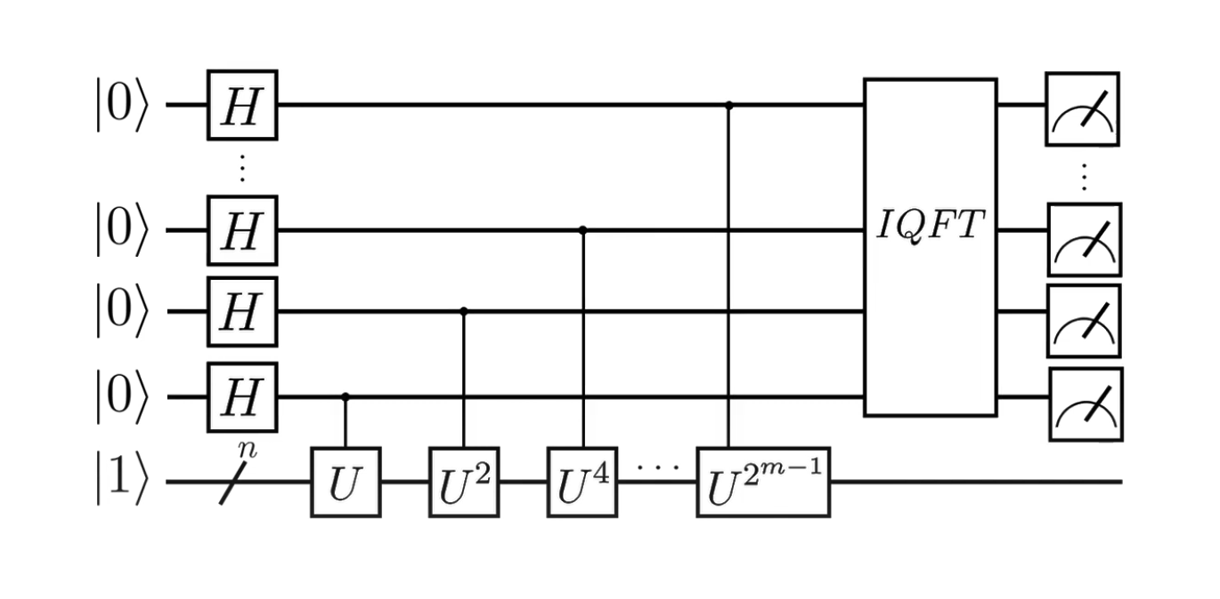
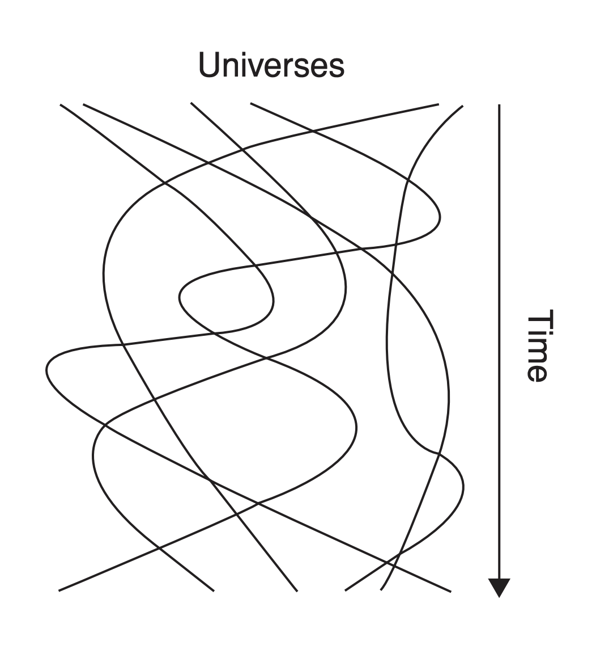
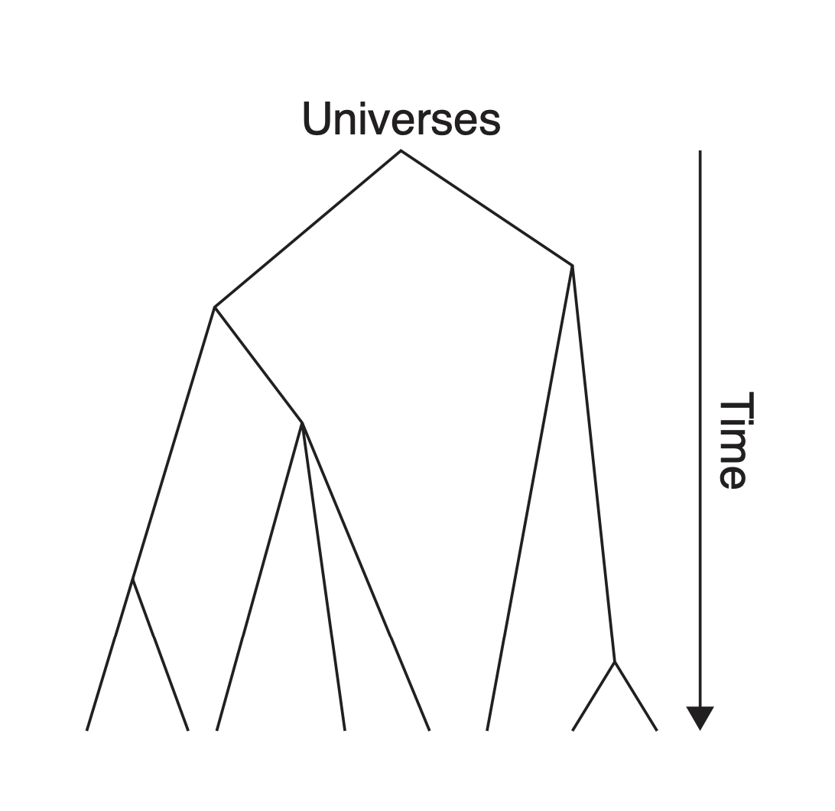
Shor’s Algorithm
Choose 1 < a < N with gcd(a,N) = 1, N = pq.
The order of a mod N is the smallest r where
a^{r} ≡ 1 (mod N)
Let a be n bits. Define an n-qubit transformation
Uₐ Ix❭ ≡ I ax (mod N) ❭
(Uₐ)^{r} I1❭ ≡ I a^{r} (mod N) ❭
U has eigenvectors Iu_{s}❭, 0 ≤ s < r with the property
U Iu_{s}❭ = exp(2πi s/r) Iu_{s}❭
— Σ_{s} Iu_{s}❭ = I1 mod (N)❭
Measuring the procedure below gives eigenvalue(s) for one s, such that we recover r. But as
a^{r} - 1 ≡ (mod N) → (a^{r/2} - 1)(a^{r/2} + 1) = N
So gcd(a^{r/2} ± 1, N) has high P of being p or q.
Quantum Supremacy
Shor works by computing superpositions of finite #possibilities simultaneously. As such, quantum computing does not mean all problems can be solved in P time by running all solutions in parallel.
Semiprime factoring is in NP and coNP, in between P and NP. Indeed, BQP and NP are incomparable:
P —— BPP —— BQP —— PP —— PSAPCE
P —— BPP —— BQP —— PP —— PSAPCE
P —— BPP —— BNP —— PP —— PSAPCE
Quantum Programming
With no cloning, what would quantum programs look like? How should variables be defined?
Category Theory
Type Theory
Logic
Quantum Linearity
1998: If Quantum gates were nonlinear, P = NP so all proof would be efficiently automated. Furthermore, you can teleport faster than light.
No-Cloning Theorem
There is no copying non-basis states, i.e. DNE A s.t.
A Ix❭ I0❭ = Ix❭ Ix❭
Proof. Let Ix❭ = a Ix❭ + b Ix❭. Then
Ix❭ Ix❭ = a² I00❭ + ab I01❭ + ab I10❭ + b² I11❭
A Ix❭ I0❭ = aA I0❭ I0❭ + bA I1❭ I0❭ = a I00❭ + b I11❭
a contradiction. □
Quantum Post-Selection
If you can post select the outcome of qubits, PostBQP = PP ⊃ NP, coNP. Example: Given a binary function taking n bits, do at least half of the inputs output 1? Output correctly with P > ½. How does this differ from BPP where P > ⅔?
1
√r
Quantum Decoherence
Why do we not observe quantum mechanics at the macroscopic scale? Consider
IΦ⁺❭ = — I00❭ + — e^{iθ} I11❭
The density matrix ⍴ is defined
⍴ = IΦ⁺❭ ❬Φ⁺I = [ ]
Decoherence says that we measure the average of all θ, so ⍴ is a diag. matrix with ½ on the diagonals.
But no such state exists with such a ⍴!
Quantum Hardware
In 2001, Shor was run on 7 qubits. In 2025, Willow has 105 qubits and 0 quantum gates. The lifetime of a qubit now is <1 second. Quantum & qubit measurement is error prone. Despite this, at the current (stable) trajectory, there is a high probability quantum computers will have commercial applications in a few decades.
1
√2
1
√2
½
½ e^{iθ}
½ e^{–iθ}
½
Quantum Speedups
Many problems have real, quantum speedups:
Quantum Fourier transform
Unstructured search problem
Discrete logarithms
Hidden subgroup problem
CHSH games
Constant vs. balanced functions
Quantum machine learning
The Quantum Revolution
A useful QC would break most modern encryption, though would open possibilities of quantum key teleportation and other post-quantum cryptographic solutions (search NIST quantum).
Discussion question: If you had a QC, would you want to tell the world? Why or why not?
Material from Quantum Computing Since Democritus by Scott Aaronson
Quantum Computation: Lecture Notes by John Watrous
Page 2
To run quantum circuit simulations go to https://quantum.ibm.com/composer
https://www.ibm.com/quantum/qiskit

